Slide 1
Email: The Backbone of Digital Communication
Ahsan Raza (22PWCSE2099)
Zarrar Ahmed (22PWCSE2132)
Mohsin Sajjad(22PWCSE2149)

Slide 2
What is an email?
Email is a digital way to communicate.
OR
Rules for how to communicate effectively, appropriately and respectfully online.

Slide 3
Basic Rules
Be Polite – Direct words may sound rude in emails
Be Thoughtful – Write with respect and consideration.
Choose Words Wisely – Be clear.
Know Your Audience – Adjust your tone based on the relationship.

Slide 4
Structure of an email:
Addressing.
Subject line.
Salutation
Message Text.
Attachments.
Signature.

Slide 5
Addressing:
The address of the recipient.
CC (Optional)
BCC (Optional)

Slide 6
Subject Line:
The email subject line is a short and clear phrase that tells the recipient what the email is about.
It should be concise, relevant, and attention-grabbing to ensure the recipient opens the email

Slide 7
Salutation:
The greeting at the beginning. It sets the tone and shows respect for the recipient.
Example: Dear Professor Johnson,

Slide 8
Message Text:
Keep the message focused and readable.
If long message, break into paragraphs.
Avoid fancy fonts.
Do not use texting language in emails.

Slide 9
Attachments:
Only when they are absolutely necessary.
Compress large attachments
Signature:
Use an appropriate signature.
Must be informative.

Slide 10
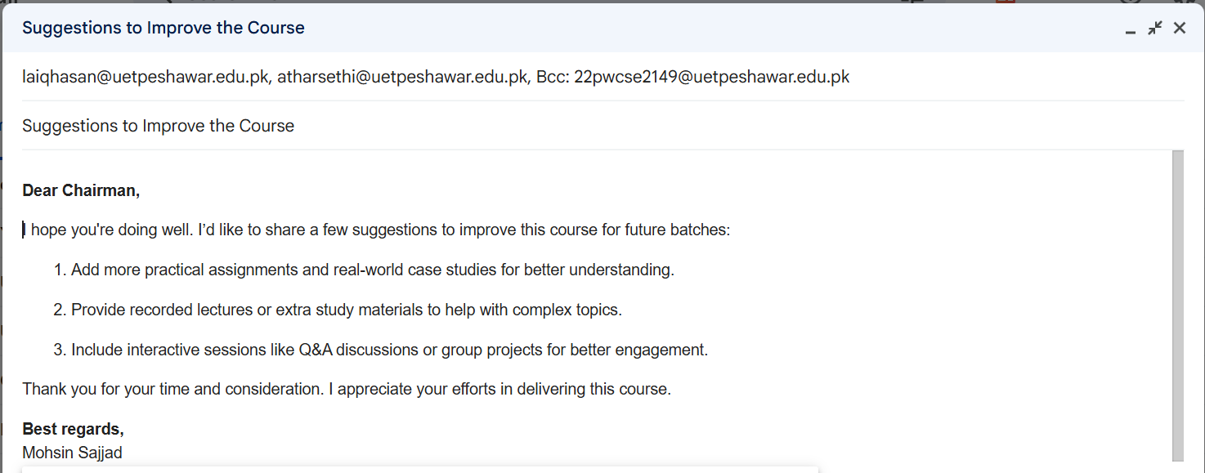
Example:

Slide 11
Befor Sending:
Check your email thoroughly for any grammatical or other mistakes.
Double check attachment that you talked about in the email is actually attached.
If your email does not get a reply after a reasonable amount of time, send a gentle reminder email.

Slide 12
Replying to Emails:
Respond swiftly preferably in 24 hours or during the same working day.
If you can not reply immediately to the email, send a short email to the sender that you have read their email and you will get back to them shortly.

